Slide 1
Airline Safety
Shilpa Kolekar DSC 640 10/10/2021

Slide 2
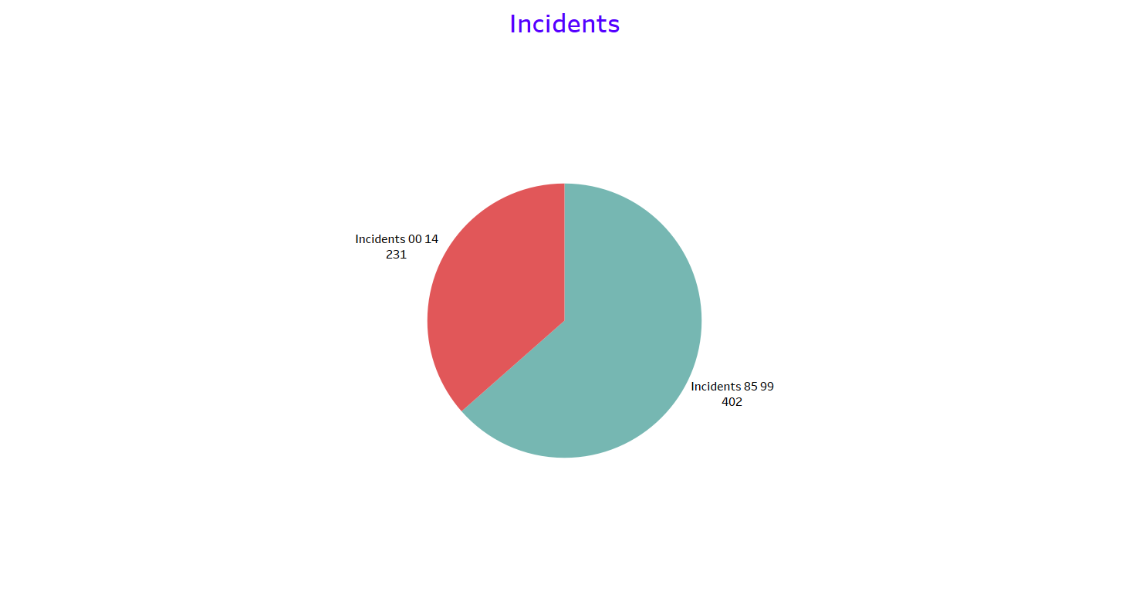
Incidents
Incidents in years 85-99 were 402
Incidents in years 00-14 were 231
Incidents drastically dropped over the time

Slide 3
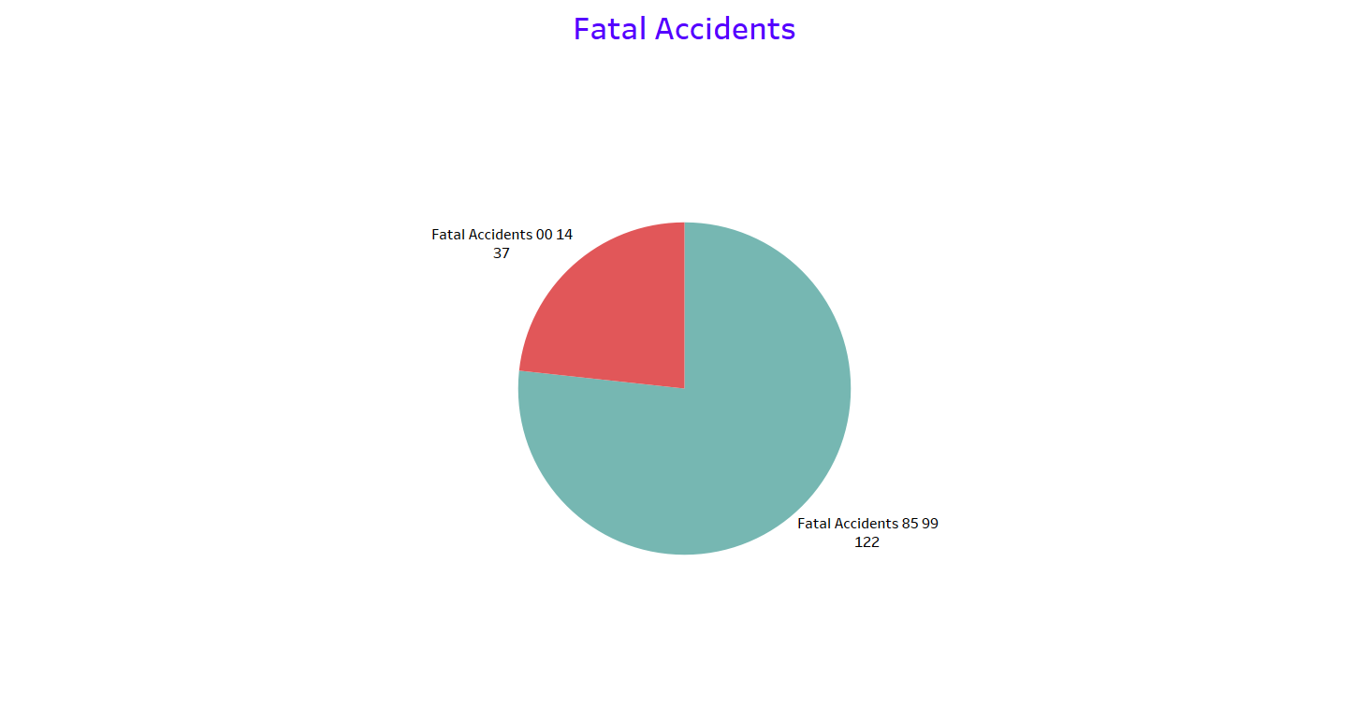
Fatal Accidents
Fatal accidents in years 85-99 were 122
Fatal accidents in years 00-14 were 37
Fatal accidents drastically dropped over time

Slide 4
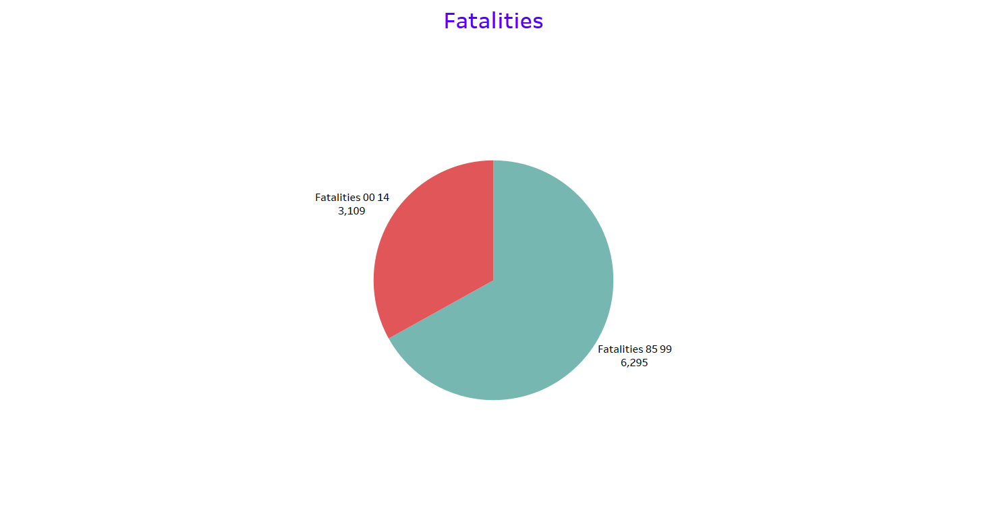
Fatalities
Fatalities in years 85-99 were 6295
Fatalities in years 00-14 were 3109
Fatalities drastically dropped over time

Slide 5
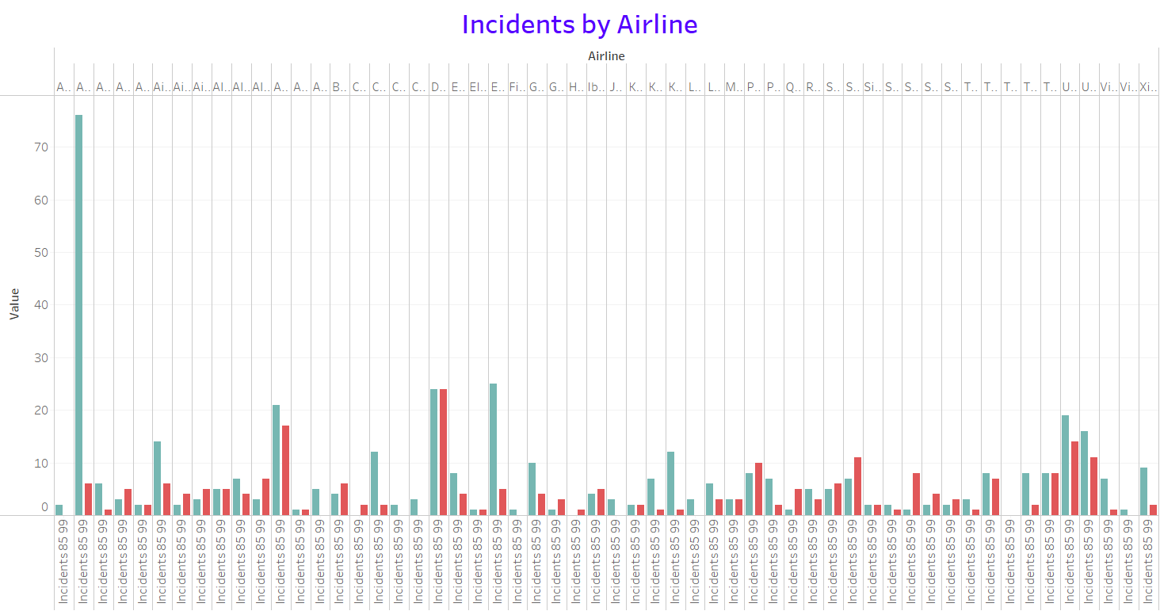
Incidents By Airline
In general, most of the airlines showed a trend where their number of airline incidents decreased over time

Slide 6
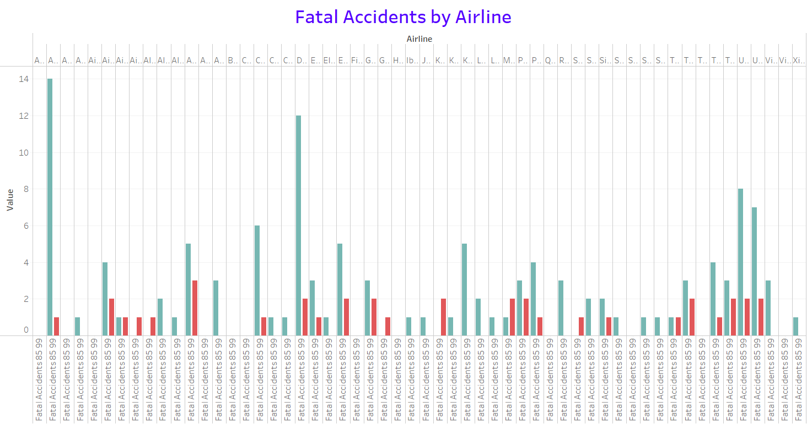
Fatal Accidents by Airline
In general, most of the airlines showed a trend where their number of fatal accidents decreased over time

Slide 7
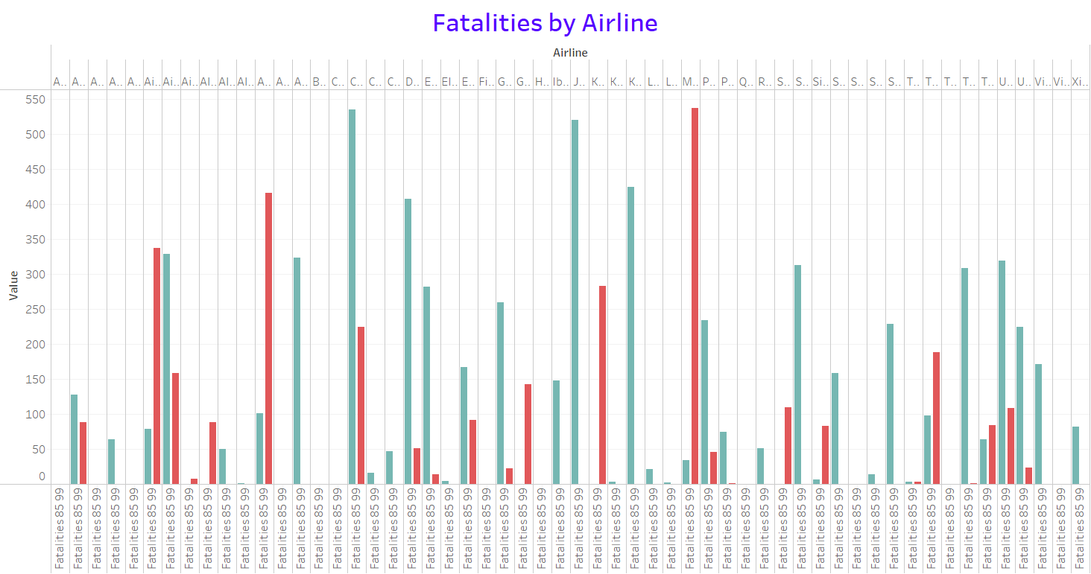
Fatalities by Airline
In general, most of the airlines showed a trend where their number of fatalities decreased over time

Slide 8
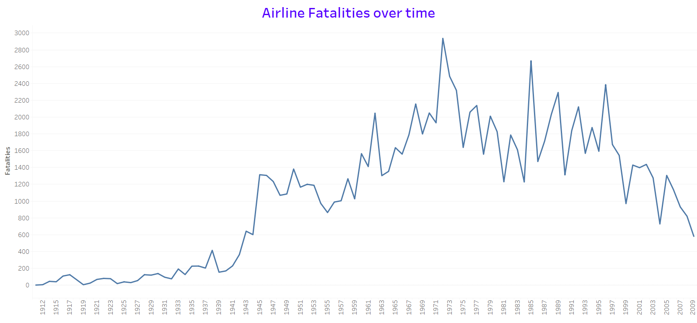
Airline Fatalities over time
Airline fatalities showed an increasing trend through 1972
The fatalities started decreasing since then

Slide 9
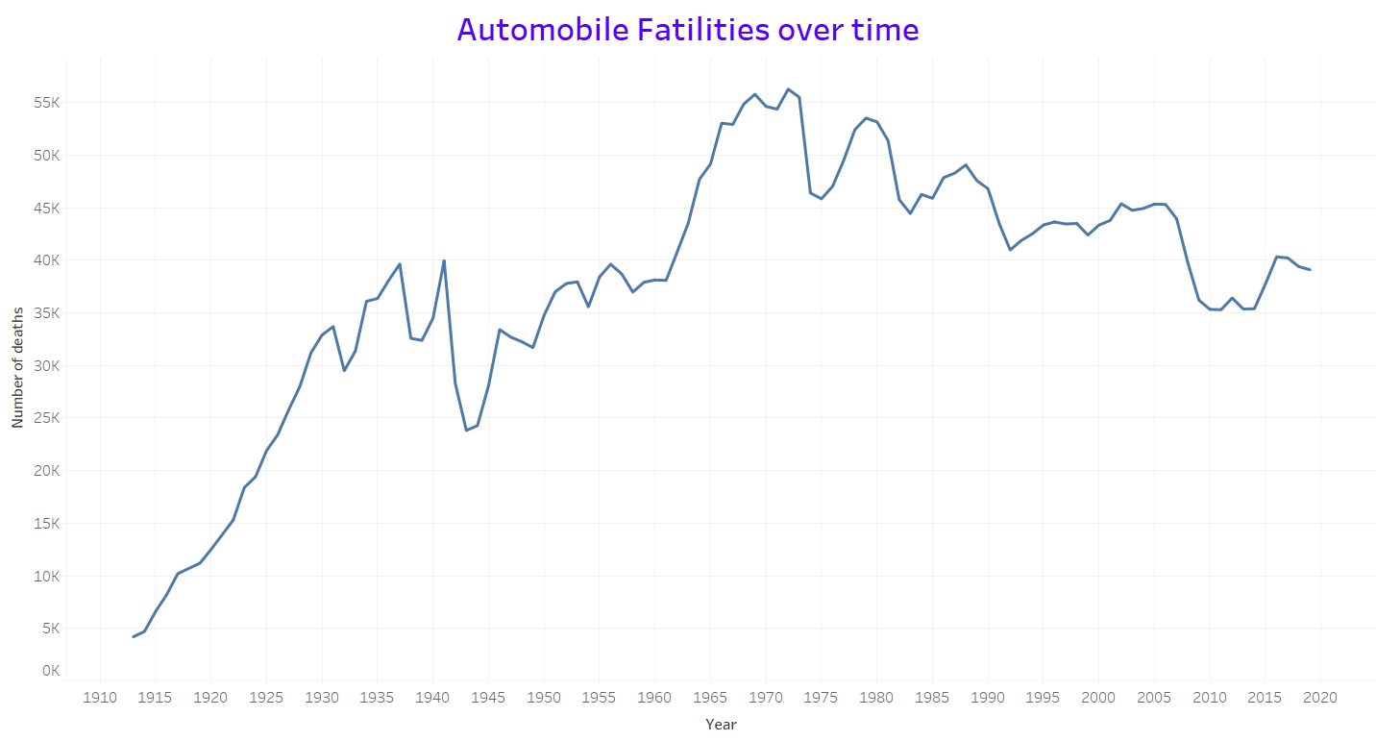
Automobile Fatalities over time
Automobile fatalities showed an increasing trend through 1972
The fatalities started decreasing since then, however at a slower rate

Slide 10
Conclusion
Total Airlines incidents, fatal accidents, and fatalities dropped significantly over time
Most of the airlines showed similar trend with decreasing incidents, fatal accidents, and fatalities
Airline fatalities had increased through 1972, but started decreasing significantly since then due to safety measures
Automobile fatalities had increased through 1972, but started decreasing slowly since then due to safety measures
Airline fatalities are way less compared to automobile fatalities over time

Slide 11
Reference
Death rate per year. Death Rate per Year | Bureau of Aircraft Accidents Archives. (n.d.). http://www.baaa-acro.com/statistics/death-rate-per-year?page=0.
Car crash deaths and rates. Injury Facts. (2021, March 29). https://injuryfacts.nsc.org/motor-vehicle/historical-fatality-trends/deaths-and-rates/.

